Slide 1
Programming with the Microsoft Graph API
Notes:
This module introduces the Microsoft Graph API and explains how this powerful library abstracts away the divisions between Azure Active Directory, Exchange Online, SharePoint Online and OneDrive to create a single, unified API for general application development. Students will learn how to program against the Microsoft Graph API in an SPFX Web Part using both the AadHttpClient class and the MSGraphClient class. The module also explains why it’s necessary to add API permission request into the package-solution.json file for an SPFX solution and how to grant tenant-level API permissions in the SharePoint Admin Center. Along the way, students will learn how to program the Microsoft Graph API to view and create users in Azure Active Directory and to read and send email messages and calendar events using an Exchange inbox.

Slide 2
Agenda
Overview of Microsoft Graph API
Programming with AadHttpClient and MSGraphClient
Configuring SPFX API Permission Requests
Granting API Permissions in SharePoint Admin Center
Creating Users and Groups in Azure AD
Programming Email Messages and Calendar Events

Slide 3
Evolution of the SharePoint/Office Platform
Web Part Packages with the release of SharePoint 2003
Farm Solutions (aka Full Trust Solutions) with the release of SharePoint 2007
Sandbox Solutions with the release of SharePoint 2010
SharePoint App Add-in Model with the release of SharePoint 2013
Applications built using the Office 365 APIs released in preview by Microsoft in October of 2014

Slide 4
Office 365 API Overview
New web service APIs for accessing data in Office 365
Implemented as RESTful services based on ODATA version 4.0
Provides authentication and authorization based on OAuth 2.0
Provides extra authentication support for OpenID Connect
Open standards provide wide range of accessibility
Many choices for tools, languages and development platforms
Microsoft has created Office 365 SDKs for specific platforms
Office 365 APIs less complex than Exchange and SharePoint APIs
No need to become a “career programmer"
Azure API
Office 365 APIs – Preview release in Q4 of 2014
Graph
API
user management
General
Exchange
SharePoint
Discovery
API
Mail
API
Events
API
Contacts
API
Files
API

Slide 5
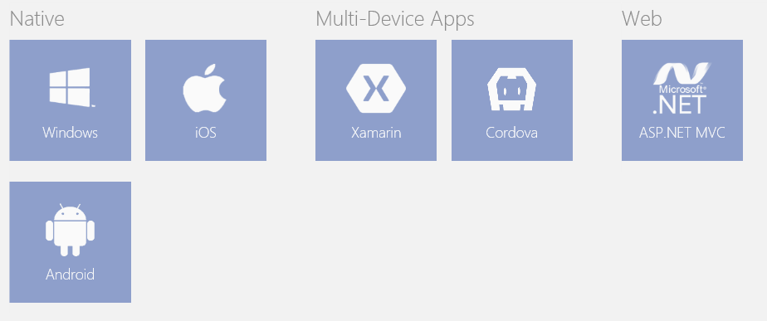
Support for Non-Microsoft Platforms
Office 365 APIs universally accessible via open standards
Any development platform can use REST, ODATA and OAuth2
Office 365 developers can use wide array of tools and languages
No hosting environment dependencies (e.g. Windows or IIS)
SDKs and extra help available for selected platforms
SDKs available for Windows, ASP.NET, iOS and Android
Choose between Visual Studio, XCode, Eclipse or Android Studio

Slide 6
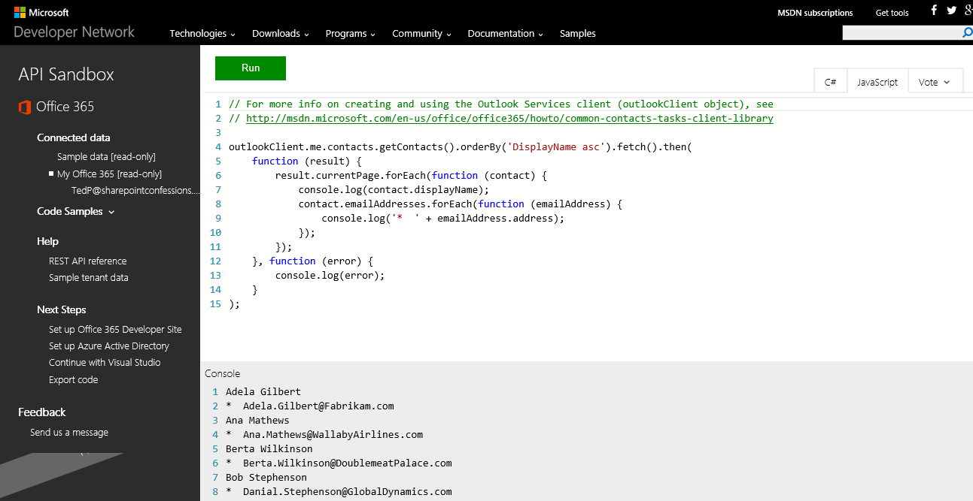
Office 365 API Sandbox
Simple online utility provided by MSDN
https://apisandbox.msdn.microsoft.com/

Slide 7
Agenda
Introduction to the Office 365 APIs
Office 365 API Service Endpoints
Understanding the Microsoft Graph API
Programming the Microsoft Graph API

Slide 8
Office 365 API Endpoint in Initial Release
Azure Endpoints
Azure Graph API
Office 365 API Endpoints
Outlook service
OneDrive for Business Service
SharePoint Files Service
Discovery Services
Discovery Service
https://api.office.com/discovery/v1.0/me
Azure AD Data
Users
Groups
Azure Active Directory Graph API
https://graph.windows.net/CptClassroom1.onMicrosoft.com
Your
Office 365
Application
Outlook Data
Mail
Calendar
Contacts
Outlook Service
https://outlook.office365.com/api/v1.0/
OneDrive for Business Service
https://myTenant-my.SharePoint.com/personal/TedP/_api/v1.0/Files
SharePoint Data
OneDrive Files
Team Site Files
SharePoint Files Service
https://myTenant.SharePoint.com/_api/v1.0/Files

Slide 9
Agenda
Introduction to the Office 365 APIs
Office 365 API Service Endpoints
Understanding the Microsoft Graph API
Programming the Microsoft Graph API

Slide 10
The Microsoft Graph API
Designed as a single, more-comprehensive service
Abstracts away divisions between AD, Exchange and SharePoint
No need to discover endpoints using the Discovery Service
You can acquire and cache a single access token per user
Azure AD Data
Users
Groups
Your
Office 365
Application
Outlook Data
Mail
Calendar
Contacts
Microsoft Graph API
https://graph.Microsoft.com
SharePoint Data
OneDrive Files
Team Site Files

Slide 11
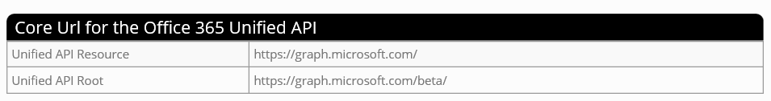
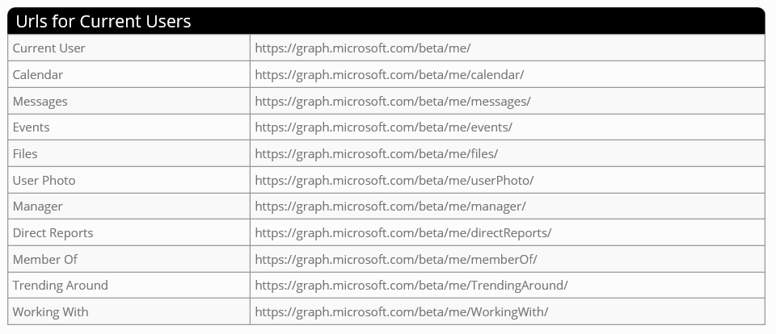
Unified API URLs

Slide 12
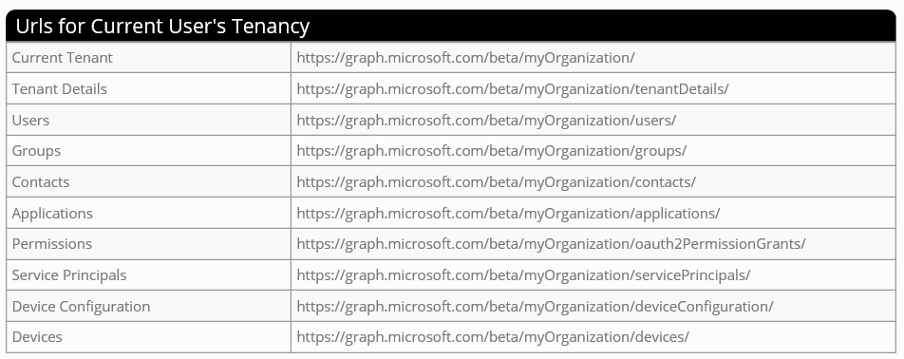
More Unified API URLs

Slide 13
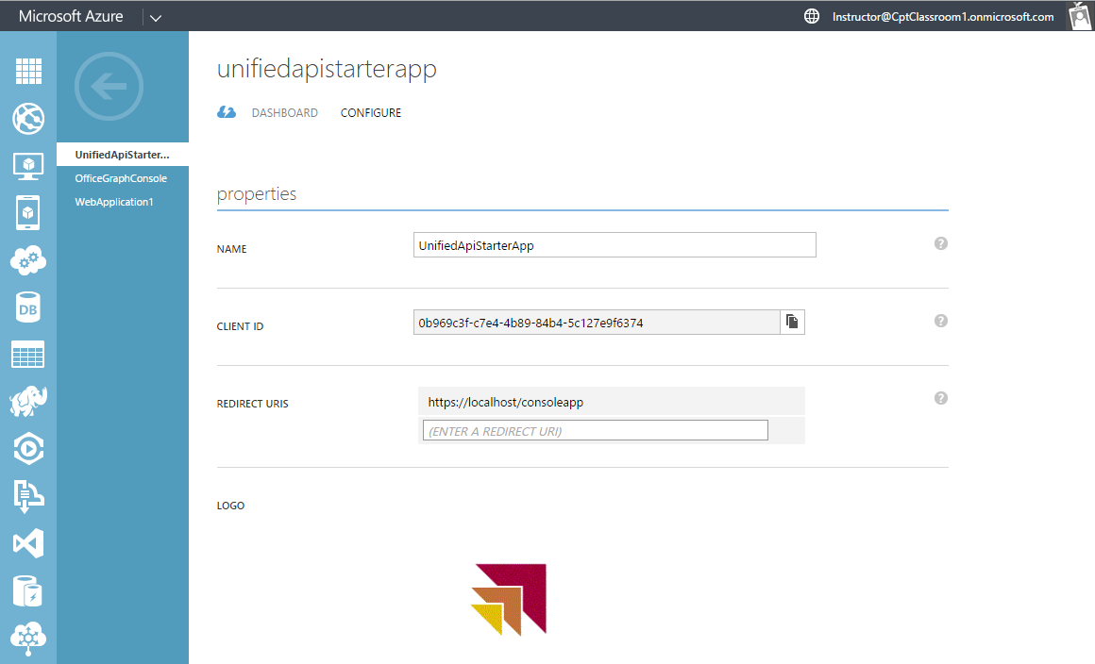
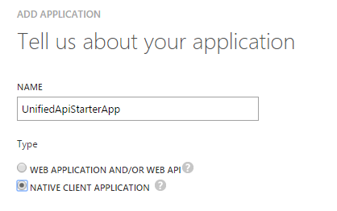
Creating an Azure AD Application
To access the Office 365 APIs…
application must first be registered with Azure Active Directory
Application registered as Web Application or as Native Client
Creating a new AAD Application

Slide 14
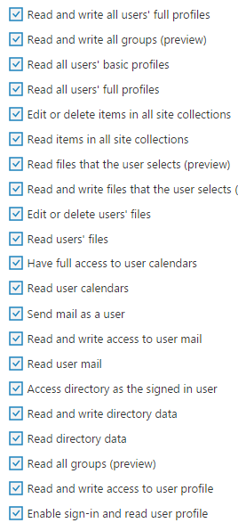
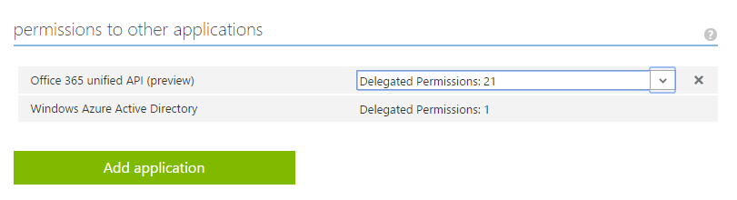
Configuring Unified API Permissions
Application required permissions in AAD
Office 365 tools in Visual Studio tools not updated yet
Permissions configured in Azure Management Portal

Slide 15
Agenda
Introduction to the Office 365 APIs
Office 365 API Service Endpoints
Understanding the Microsoft Graph API
Programming the Microsoft Graph API

Slide 16
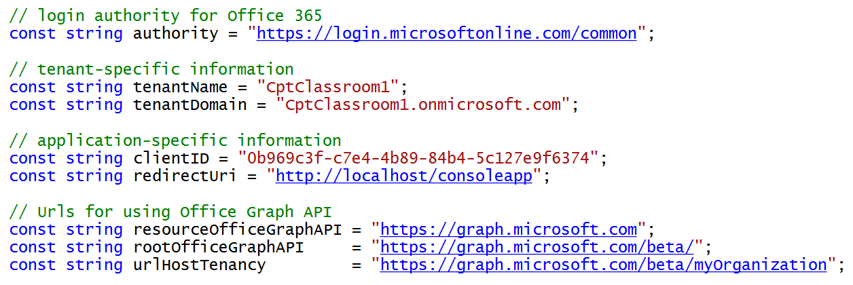
Adding Application Constants
Application requires tenant and app-specific information

Slide 17
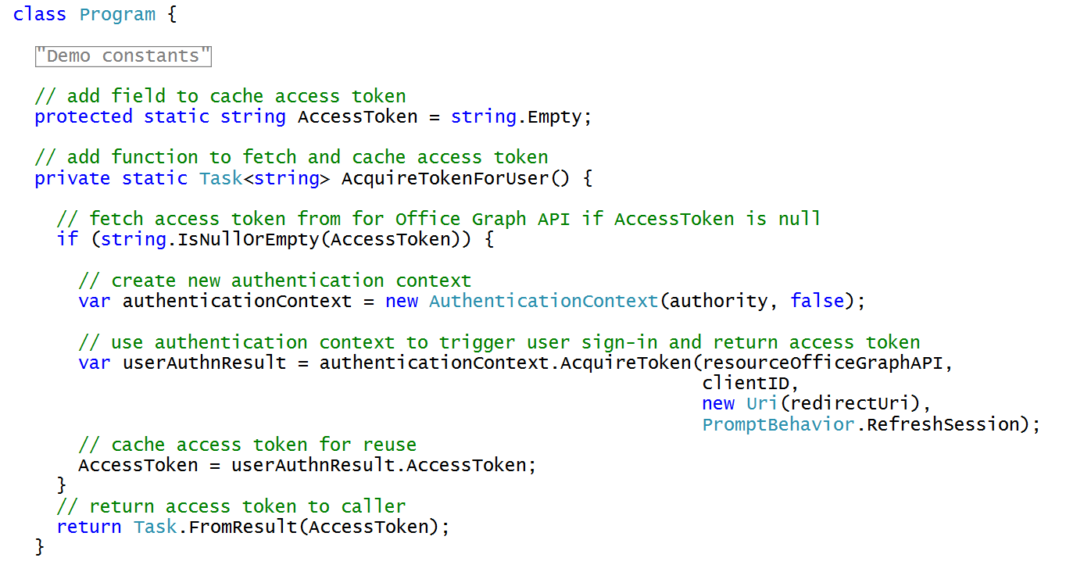
Acquiring and Caching Access Tokens

Slide 18
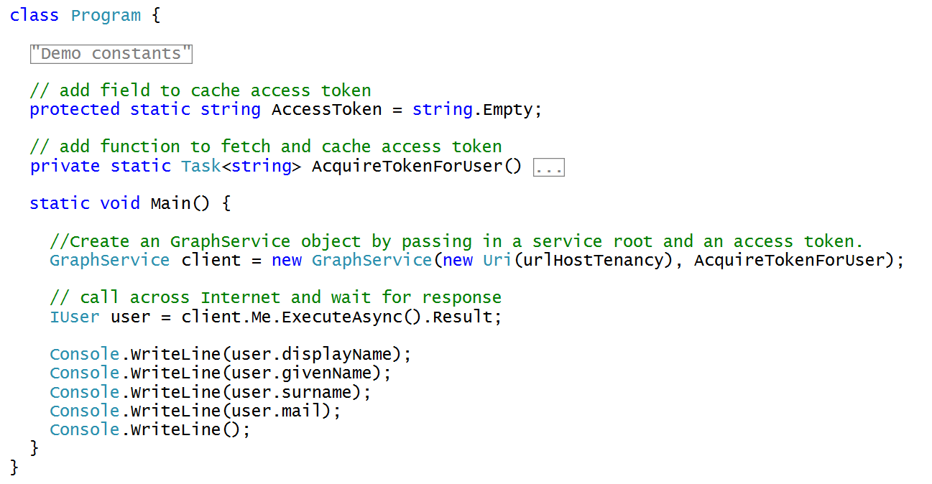
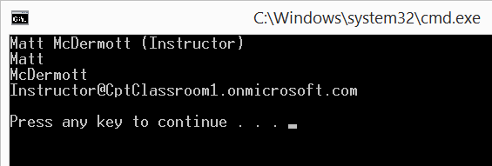
Writing the "Hello World" Code

Slide 19
Office 365 Apps vs SharePoint Apps
Points of comparison
Types of applications
Authentication Architecture
Installation/deployment scope
Permission granularity
Launching an App
Maturity of Platform
Inline with Microsoft’s Strategy and direction

Slide 20
Learning Resources
Microsoft online resources
http://Dev.Office.com
https://apisandbox.msdn.microsoft.com
Office 365 Developer content on GitHub
https://github.com/OfficeDev
On-demand Puralsight Course by Andrew Connell
Office 365 APIs: Overview, Authentication & the Discovery Service

Slide 21
Summary
Introduction to the Office 365 APIs
Office 365 API Service Endpoints
Understanding the Microsoft Graph API
Programming the Microsoft Graph API

